Slide 1
Portfolio Project 1
How age influences shopping preferences
To see how businesses should market towards different age demographics

Slide 2
In this project, I used data from Kaggle to analyse the differences in shopping trends by age. More specifically, how frequently different age groups shop and how much they spend.
I used Python to analyse this data.
I grouped the ages in to the following categories:
18-24
25-32
32-45
45+

Slide 3
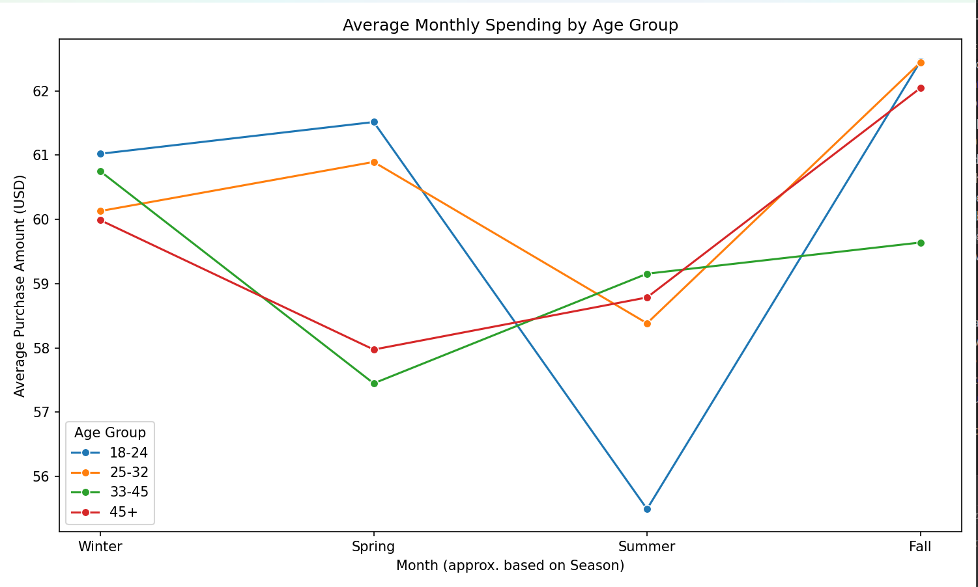
Findings

Slide 4
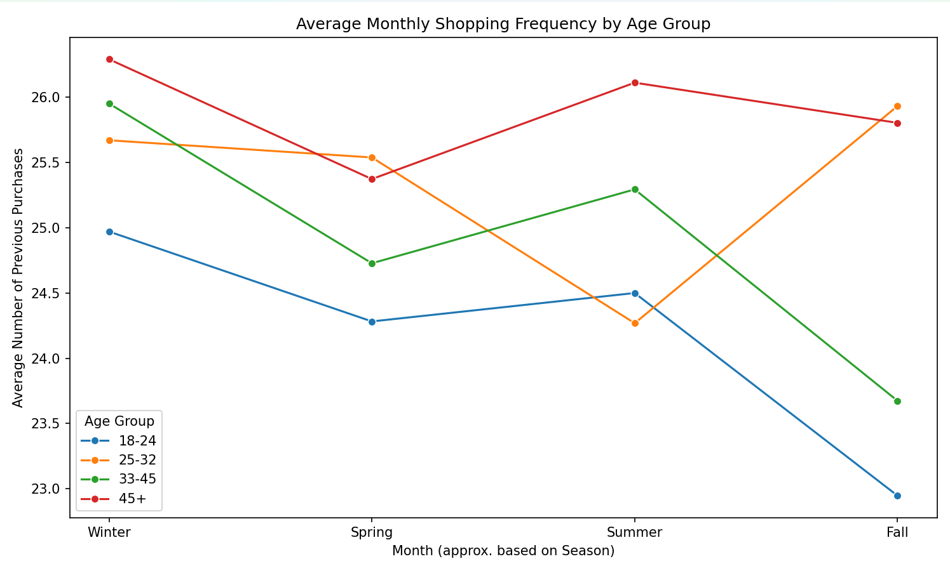
Findings

Slide 5
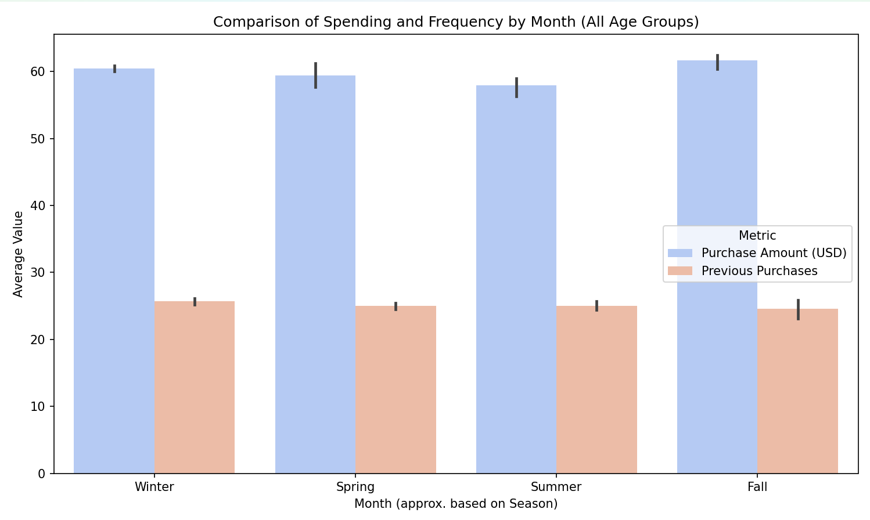
Findings

Slide 6
Findings – monthly spending
I found that in the winter, the youngest age groups spend the most, but in the summer, they spend the least.
People aged 18-24 spend the most in the winter and spring and then the least in the summer. I would have to look deeper to draw a definite conclusion, but I suspect the reason being is potentially they spend beyond their means early in the year, meaning they have less disposable income for the summer. Another potential reason is because summer is seen as a holiday season, prices hike making it less affordable for younger people.
The older age groups, spend a consistent amount year-round and we can see that their spending habits do not go from one extreme to another, suggesting that the reason that they may spend the most in summer is down to proper money management.

Slide 7
Findings – shopping frequency
With the shopping frequency, I found an outlier with the age group 25-32.
Across the rest of the board, we can see that shopping habits peak in summer, take a dip in Autumn (fall), peak again in winter and dip again in spring.
Age group 25-32 take their largest dip in shopping frequencies in the summer.

Slide 8
Evaluation
I was able to draw out some solid findings however, the data used came from a singular data set. Furthermore, this dataset was only based on US consumers, therefore this data is not applicable to the rest of the world.
To draw deeper conclusions and to provide businesses with predictions on how they can market towards different age demographics, I would need to look at a variety of datasets. Analyse more data, such as differences by gender, analyse salaries etc.
I would also use smaller age groups. For example, 18-21, 22-25.

Slide 9
Thank you
- Kiara Stephens

